Slide 1
BEECH WATER PRESSURE PROJECT
Survey Response – Key headlines
50% response rate
20.4% of ALL households have had problems associated
with high water supply pressure
Typical damage and repair costs £1000 - £3000
(highest estimated at £40k)

Slide 2
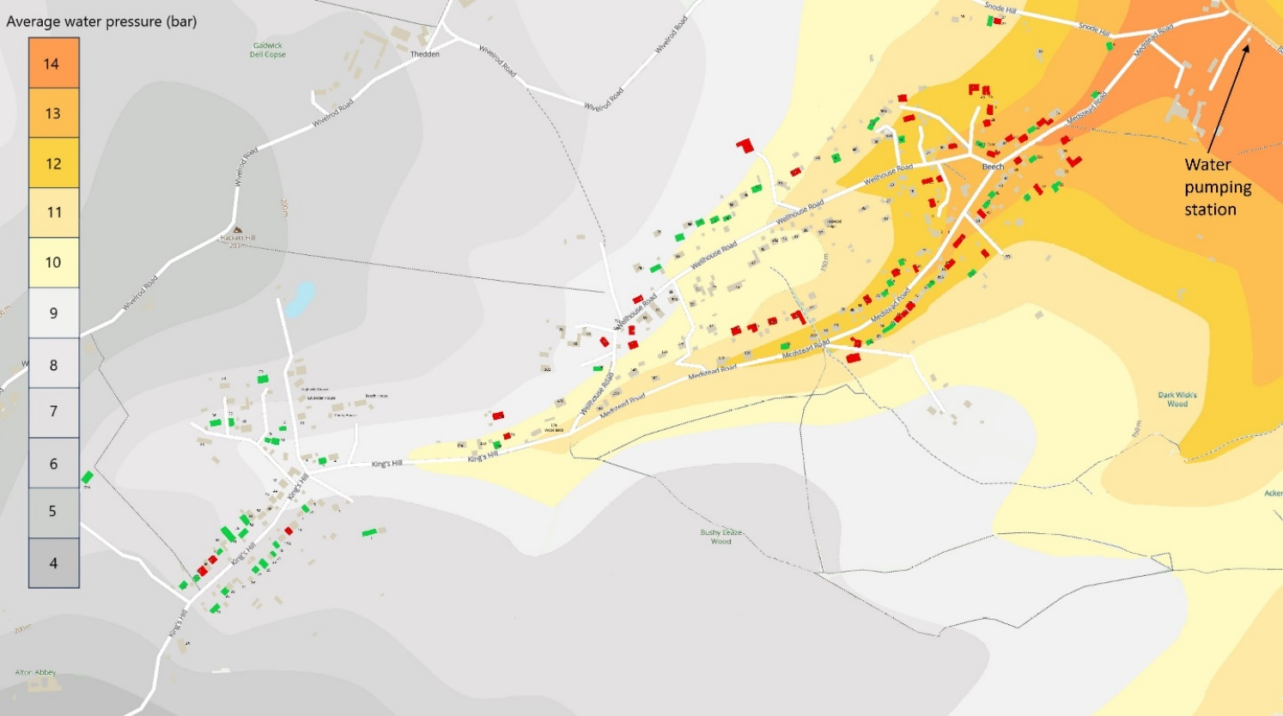
Water supply pressure “heat map”

Slide 3
Supply Pressure segmentation - results

Slide 4
BEECH WATER SUPPLY QUESTIONNAIRE
COMPARISON OF PROBLEM INCIDENCE AT DIFFERENT WATER SUPPLY PRESSURES
Supply @ 12+ bar
Supply @ <8 bar
Over 5 times more households in Beech have had leaks and other problems where supply pressure is highest.
A supply pressure of <8bar is the norm for most UK households.

Slide 5
Households with pressure related problems at different supply pressures
%
%
%
%

Slide 6
Water Supply – Regulations & Technical Standards
GSS Regulation – on Low Pressure:
A company must maintain a minimum pressure in the communication pipe of seven metres static head (0.7 bar)
OFWAT statement on High Pressure:
“Water companies should make sure that high water pressure does not cause damage to a customer’s property if the customer’s fittings meet normal standards.”
Relevant British Standards: BS EN 12201-2:2011
Maximum Working Pressure of 25mm blue pipe = 12.5 bar
[Note: SE Water documentation states 10 bar]

Slide 7
Conclusions and Recommendations
SE Water have stated that they supply water at 13-14 bar from their pumping station
Customer pipework is rated at 12.5 bar. [SE Water recommend 10 bar max.]
There is no surprise that we have a problem in the lower end of Beech
RECOMMENDATION:
The Parish Council re-engage with SE Water to explain our work and findings:
Request they respond in a timely manner (waited 6 months and counting)
Strongly request that they address the supply pressure situation at 12+ bar households
(or even 10+ bar households)
Suggest the offer to fit PRV’s at the meter output to protect customer owned pipework.

